Slide 1



EBSCO Webinar for the AUEB: EBSCO eBooks Business Subscription Collection
Tibor Foltinsky – January 26, 2025

Slide 2
Webinar Agenda
Summary of content in the eBook Business Subscription Collection
What are publisher permissions
How to access eBooks on mobile devices
Live demo
Q&A

Slide 3
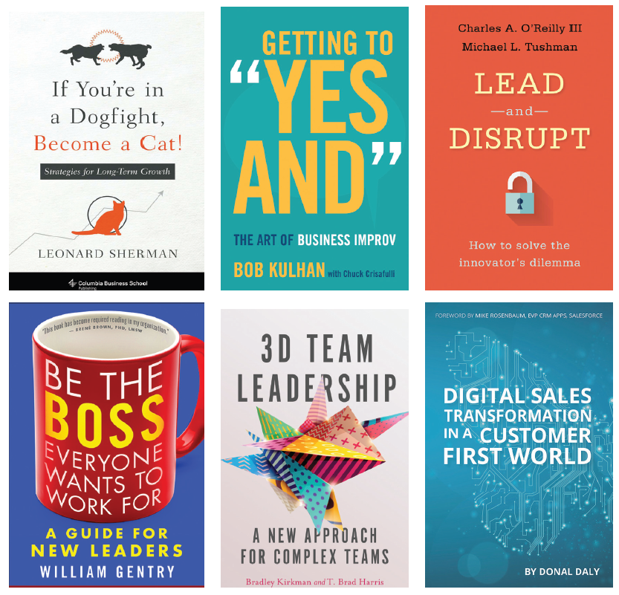
EBSCO eBooks Business Subscription Collection
Contains more than 21 000 e-books across a wide variety of business-related topics including:
Leadership
Sales and Marketing
Human Resources
Finance
Project Management

Slide 4
EBSCO eBooks Business Subscription Collection
Over 430 parent publishers, including Taylor & Francis, Elsevier, AMACOM, Bloomsbury, and more
Unlimited User Access with no Turnaways
Over 180 Choice OAT eBooks
Over 2,500 DRM-Free eBooks
Complimentary MARC Records

Slide 5
EBSCO eBooks Business Subscription Collection
Available Format types: EPUB and PDF
EPUB is better for mobile devices, PDF is better for citing
How to search for eBooks by format:
For EPUB, add AND FM EK after your search terms (or use the EPUB filter)
For PDF, add AND FM EB after your search terms
We recommend placing a phrase or multiple keywords connected by the operators AND/OR/NOT in parentheses:

Slide 6
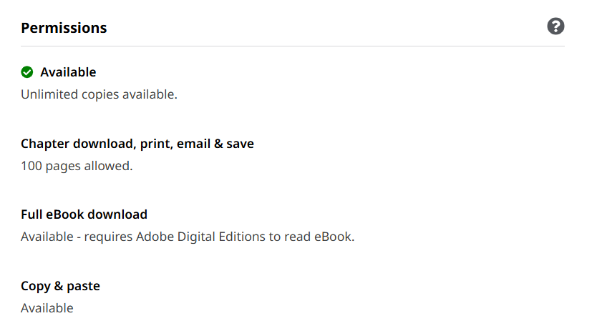
EBSCO eBooks Business Subscription Collection
Publisher Permissions

Slide 7

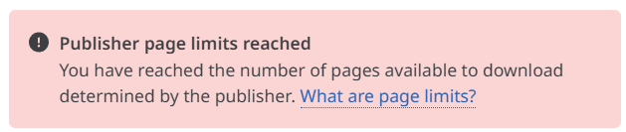
Publisher limits for downloading part of an eBook
The limit ranges from 15 to 100 pages, and once used up, it is reset:
After successful manual logout from the platform
After 24 hours of inactivity (standard timeout)
In case of institutional federated authentication for remote access, automatic logout may occur after a shorter period of inactivity (this depends on your institution’s specific settings)
The limit is applied at the user level, not at the institutional level
If the limit does not reset after logging out, we recommend clearing the browser's cache and cookies.

Slide 8
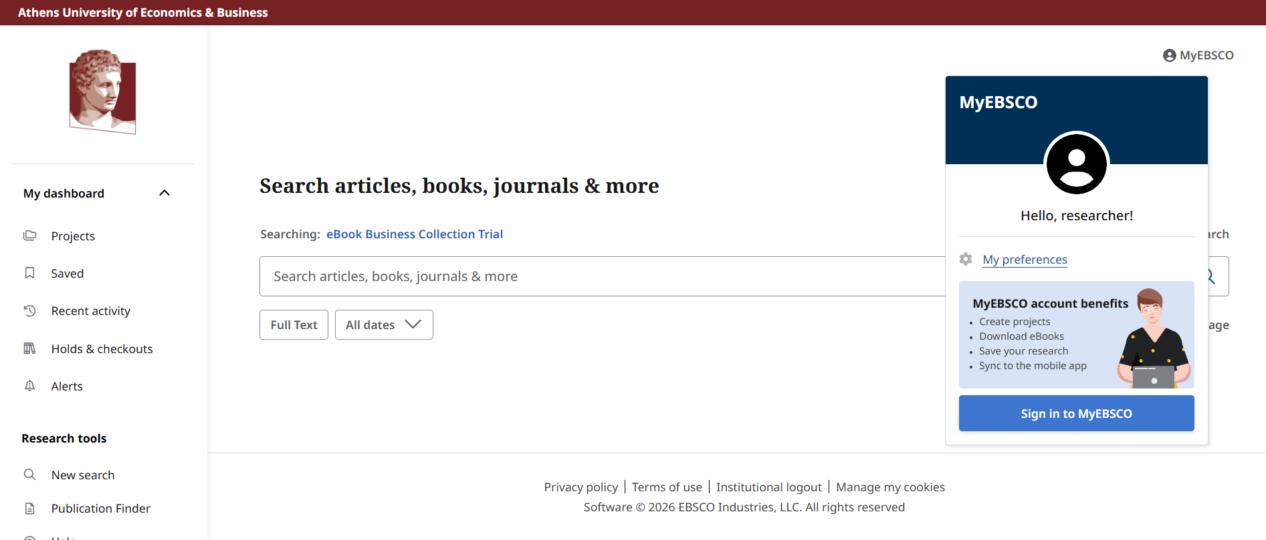
How can you manually log out from the platform?
If you are not logged into your MyEBSCO account

Slide 9
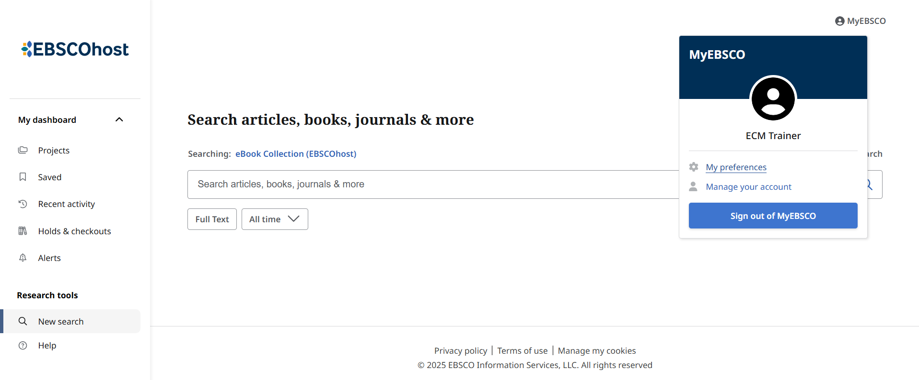
How can you manually log out from the platform?
If you are logged into your MyEBSCO account
If you are still on the platform after logging out of your MyEBSCO account, click the 'Institutional Logout' button (see previous slide)

Slide 10
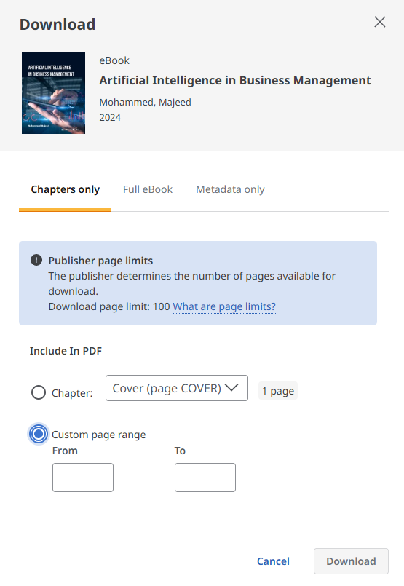
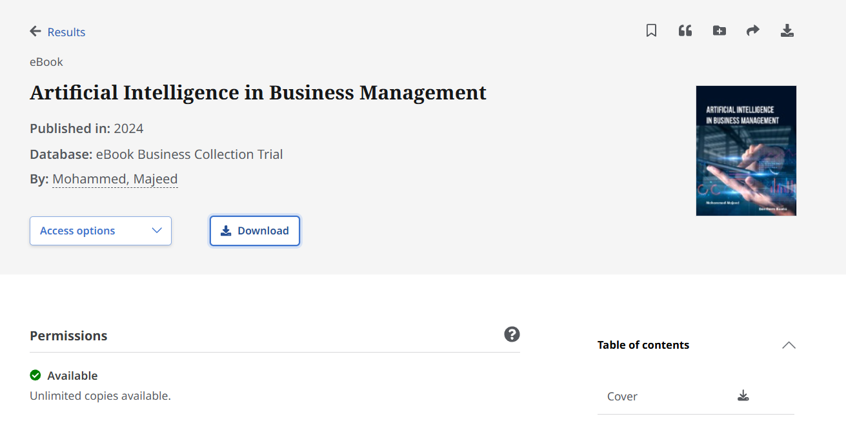
Download a chapter or part of the e-book in PDF format

Slide 11
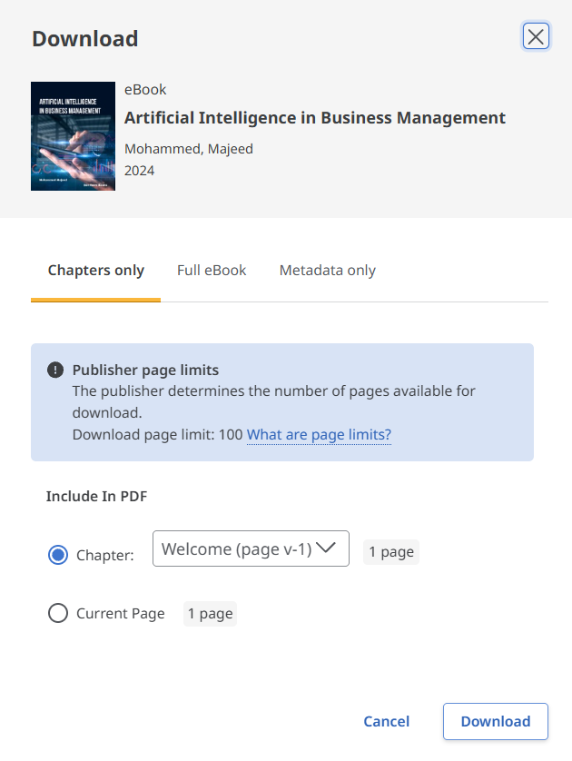
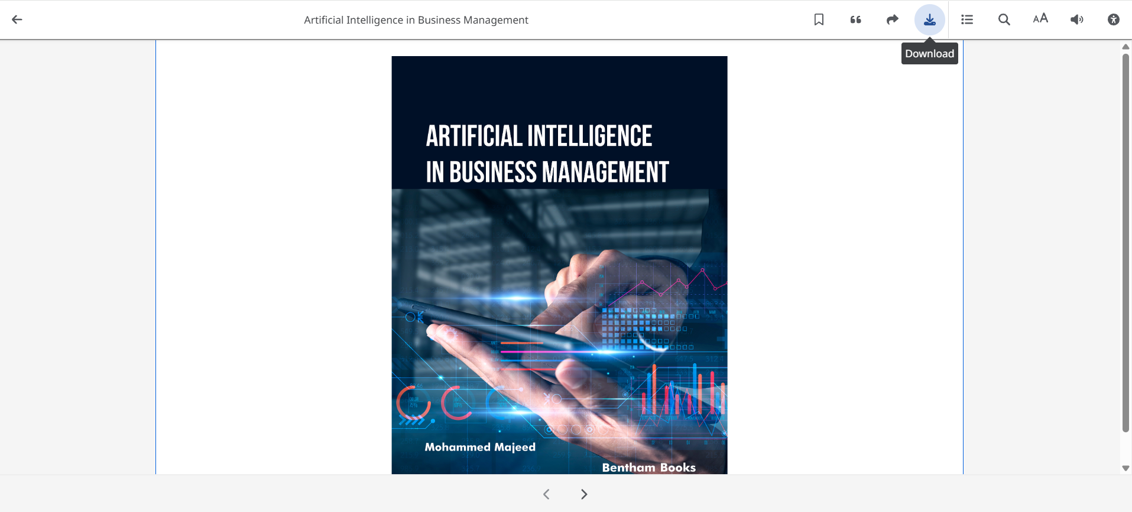
Downloading a chapter in PDF format while reading the full text in EPUB format
Notes:
EPUB does not have pages – therefore you cannot choose a custom range

Slide 12
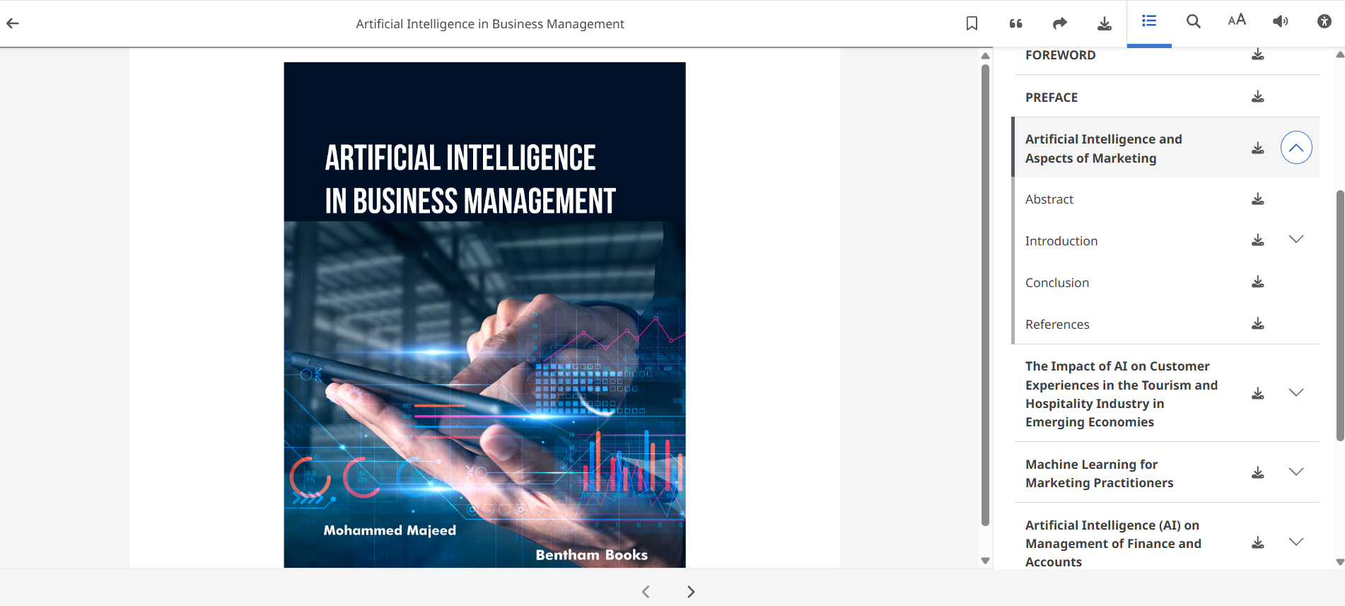
What to do if a chapter has more pages than the publisher's limit
Navigate to the content and click on the chapter – this will display the individual subchapters
If a subchapter also has more pages than the limit, use the function to download the current page or choose the PDF format to access the full text.

Slide 13
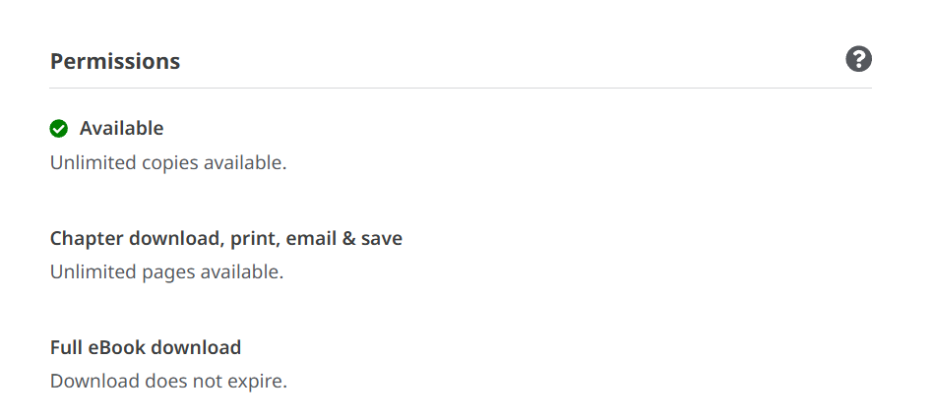

DRM-Free eBooks

Slide 14
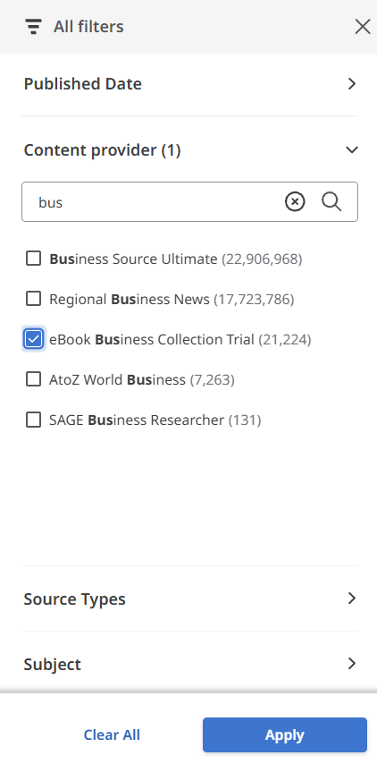
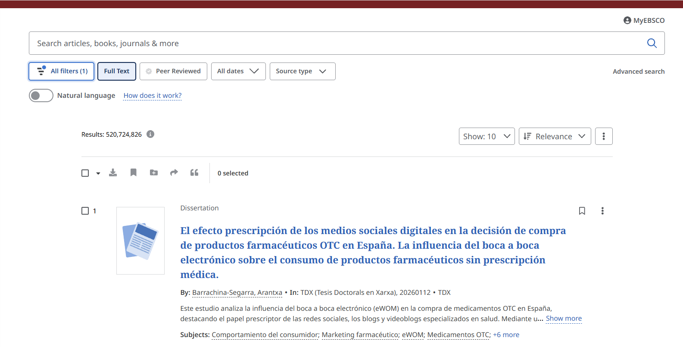
How to find this collection in EDS?
Notes:
Run an only filter search with full text filter >>> All filters >>> Content provider

Slide 15
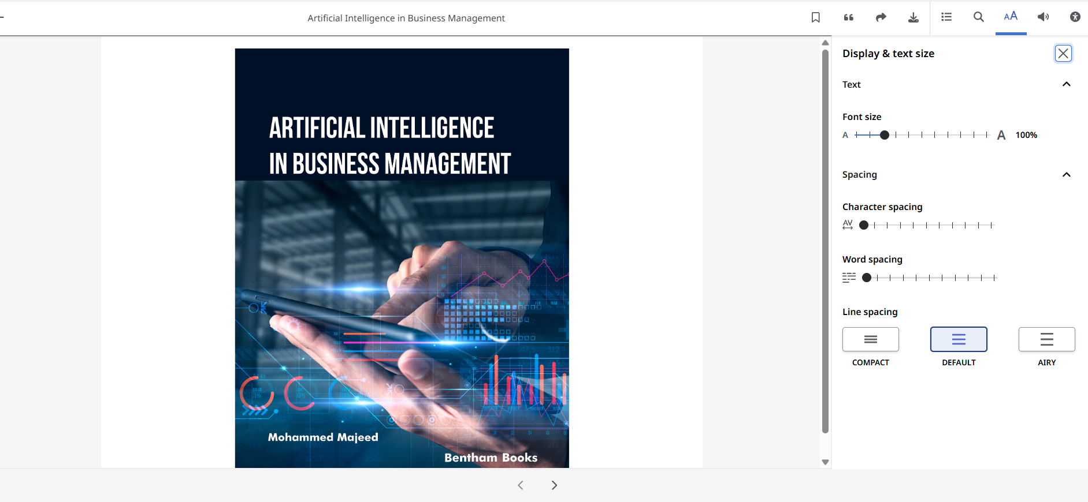
eBooks EAA related accessibility features
These settings are only possible with the EPUB format

Slide 16
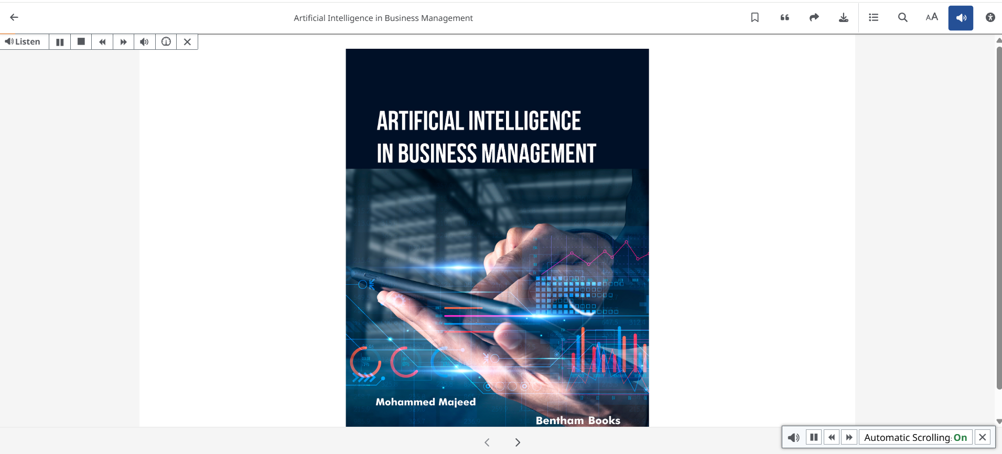
eBooks EAA related accessibility features
Text-to-speech is possible both for EPUB & PDFs

Slide 17
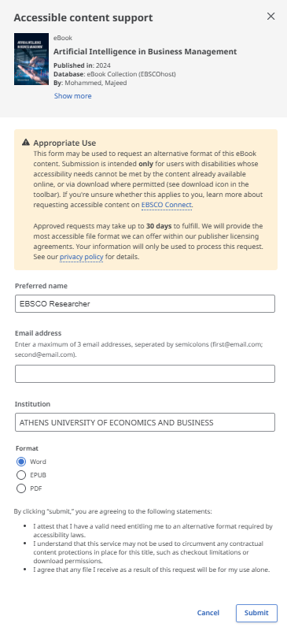
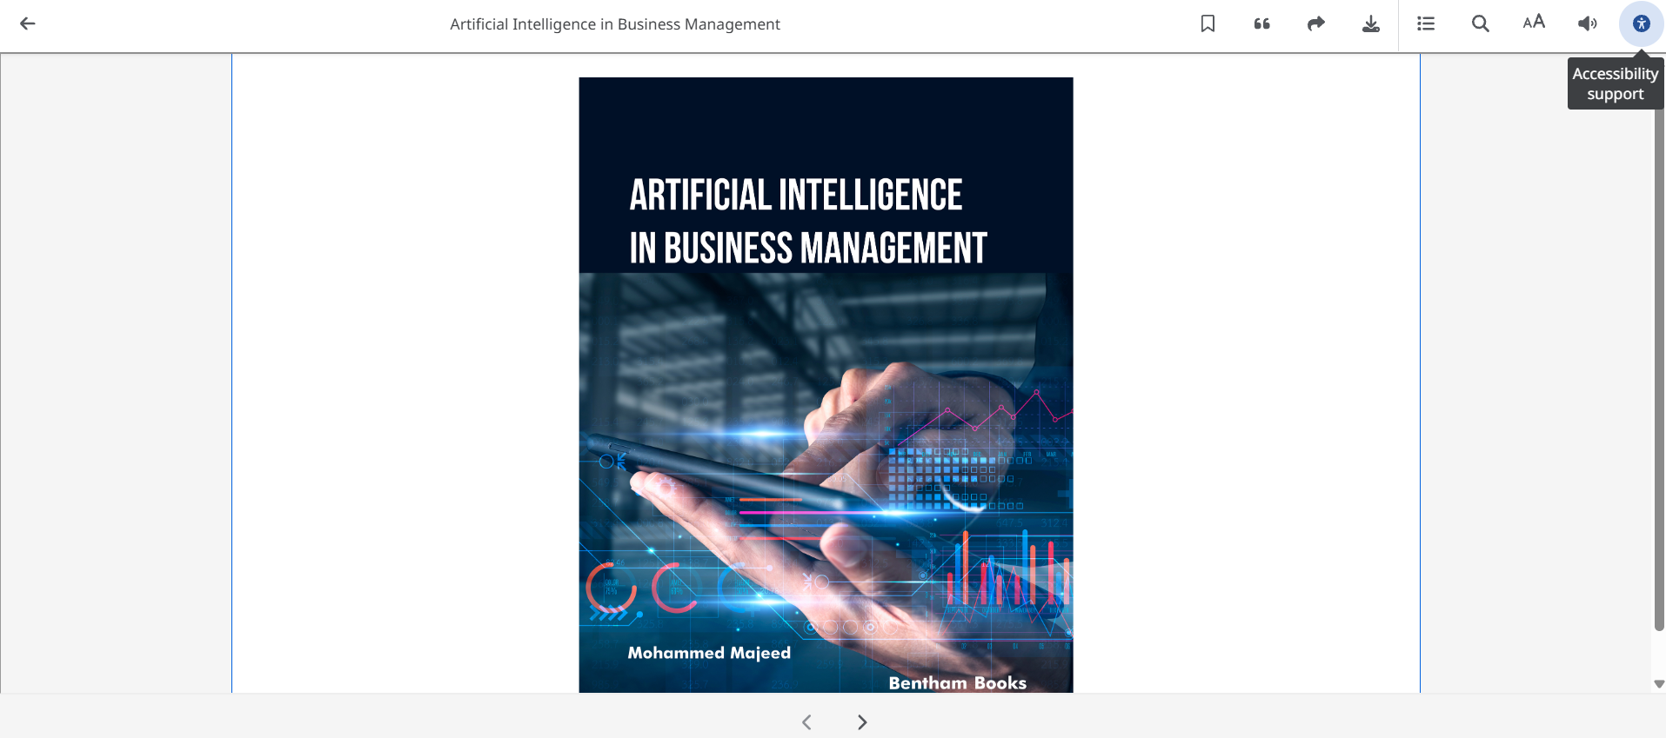
eBooks EAA related accessibility features

Slide 18
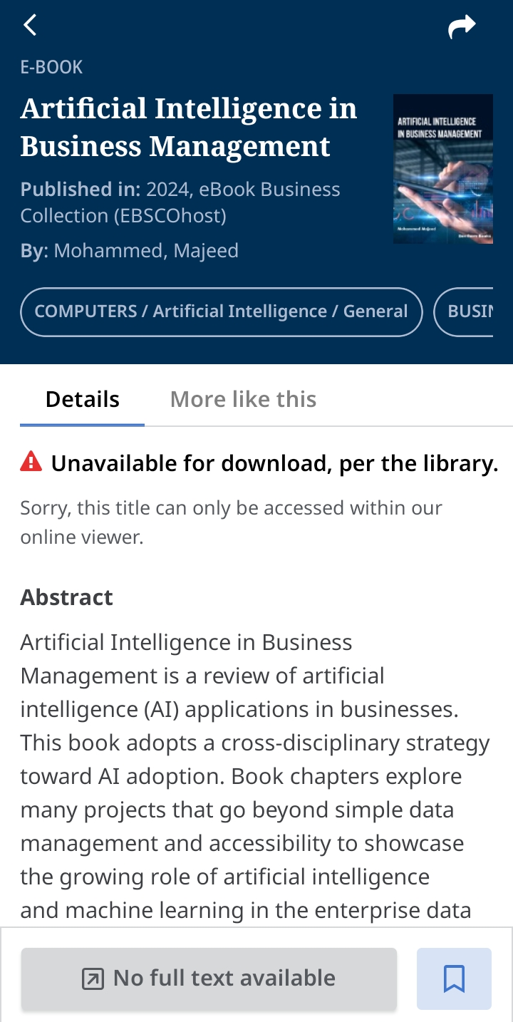
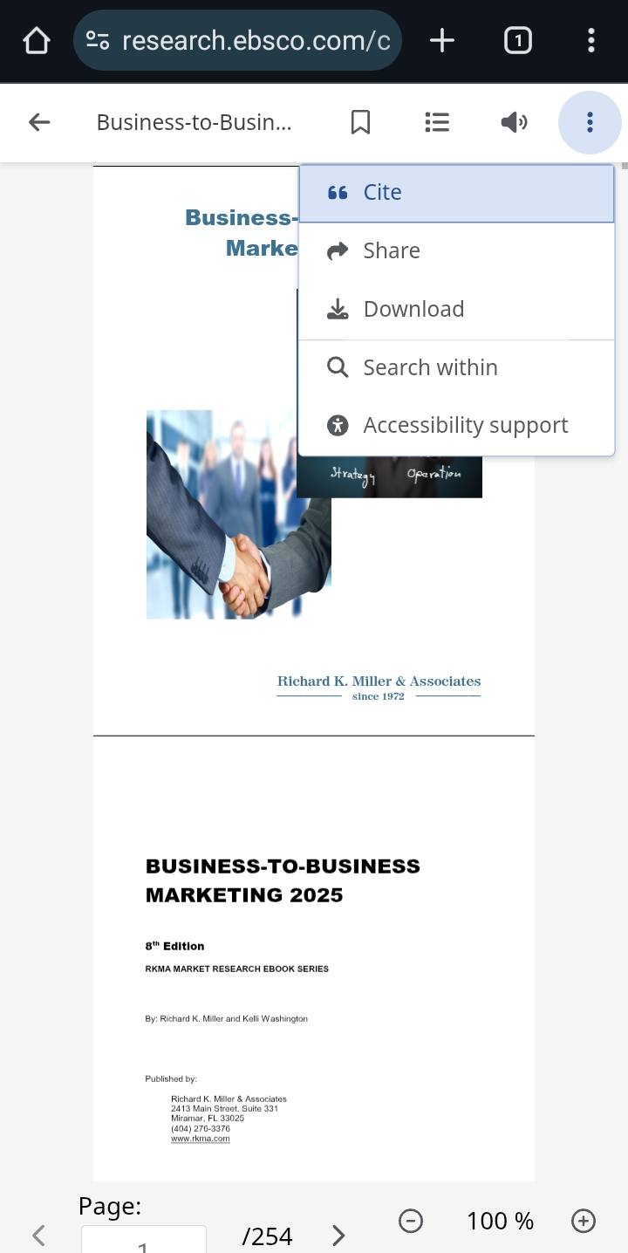
Reading eBooks on mobile devices
EBSCO Mobile App:
eBooks reader in the browser on your mobile device

Slide 19

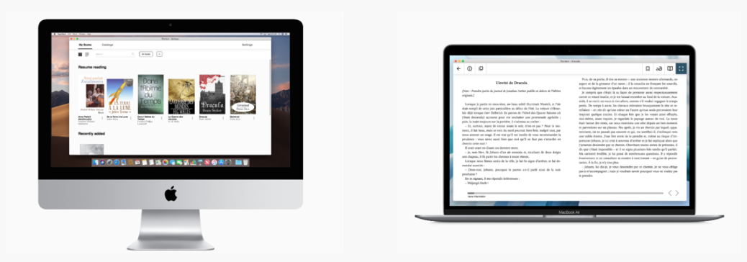
New DRM Solution is on the Way
Implementation plan:
April 2026

Slide 20
Demo Time!

Slide 21
Useful resources
EBSCO eBooks on the New EBSCO Interfaces User Guide
EBSCO Adopts New DRM Solution to Enhance Library Services
EBSCO eBooks - LCP & Thorium - Frequently Asked Questions

Slide 22
Room for your questions
tfoltinsky@ebsco.com

Slide 23
Thank you for your attention!
tfoltinsky@ebsco.com

